Slide 1


Major Project Presentation
“SmartChem – An Intelligent De Novo Molecule Generation Platform for Drug Discovery”
Nishant Singh Bisht (2200100100228)
Navya Singh (2200100100219)
Nishant Kumar Singh(2200100100225)
Shivam Sahani (2200100100313)
Under The Supervision of:
Mr. Sachin Kr Sonker

Slide 2
Outline
Introduction
Literature Review
Identification of Problem Domain
Feasibility of Project Proposal
Objectives
Methodology of the Proposed Work
Project Roadmap & Timeline
Progress Till Date
Future Work
Conclusion
References

Slide 3
Introduction
Drug discovery is slow, costly, and requires screening millions of molecules
Early-stage “Lead Identification” is a major bottleneck
SmartChem accelerates this using AI-driven molecular generation
Platform capabilities:
De-Novo Molecule Generation
Virtual Screening (ADMET + Toxicity)
Smart Assistant powered by LLMs
End-to-end system integrating ML, backend, and UI

Slide 4
Literature Review
Variational Autoencoders (VAE) have been used for de novo molecular generation in SMILES/SELFIES space
Latent space optimization is a common approach for targeted molecule design
RDKit is widely used for molecular property calculation (QED, LogP, MW)
LLMs in chemistry: Context-aware suggestions improve understanding of molecular behavior
Existing platforms are complex—SmartChem simplifies research workflows for academic usage

Slide 5
Identification of Problem Domain
Manual synthesis and screening of molecules is expensive and slow
Students lack access to professional computational chemistry tools
Hard to understand complex molecular properties without visual + AI assistance
No unified tool exists in your domain integrating generation, analysis, and assistant guidance

Slide 6
Feasibility of Project Proposal
Technical Feasibility
ML pipeline uses lightweight PyTorch models trained/offline-loaded
FastAPI backend efficiently handles generation, optimization, and database access
MongoDB Atlas enables scalable cloud storage
3Dmol.js renders molecules directly in the browser
Operational Feasibility
Students can easily explore molecular design
Single-click workflows for generation → analysis → saving
Economic Feasibility
Entire system uses open-source libraries + free Groq API

Slide 7
Objectives
Build an end-to-end platform for AI-assisted molecule creation
Enable users to generate random or targeted molecules using VAE + Predictor
Provide a Virtual Lab for structural, ADMET, and toxicity analysis
Integrate a Smart Assistant powered by Groq Llama-3
Allow storing molecules in organized projects via MongoDB

Slide 8
Methodology of the Proposed Work
Data Representation: SELFIES → One-hot encoding
Model Loading: VAE + Predictor loaded on backend startup
Generation Methods:
Random sampling from latent space
Targeted optimization using gradient descent
Property Calculation: RDKit for QED, LogP, MW, ADMET
Virtual Lab:
3Dmol.js for rendering
Smart Assistant uses Groq API with molecule context
Database: MongoDB storing users → projects → molecules
Frontend: React + JWT Authentication + REST API

Slide 9
Project Roadmap & Timeline
Phase 1 — Data & Model Development
Dataset cleaning & SELFIES tokenization
VAE architecture setup & training
Property Predictor training & evaluation
Phase 2 — Core Backend Development
MongoDB schema design
Authentication (JWT + Refresh tokens)
Project & Molecule CRUD APIs
Phase 3 — AI Integration Layer
Connect trained VAE + Predictor to backend
Implement generation (random/targeted) APIs
Lead optimization workflow
Phase 4 — Virtual lab & Frontend
3D structure generation & viewer
Property computation & analysis panels
Chat-based Smart Assistant integration
Library + Design Studio UI
Phase 5 — Testing & Finalization
End-to-end integration testing
Performance tuning & bug fixes
Preparing demonstration workflows

Slide 10
Progress Till Date
Fully working VAE generator
FastAPI backend running with JWT auth + MongoDB Atlas
All CRUD APIs implemented (projects + molecules)
Virtual Lab operational with 3D viewer + ADMET panel
Smart Assistant functional using Groq Llama-3
Frontend synced with backend using token refresh + real DB data
Save molecule workflow completely validated

Slide 11
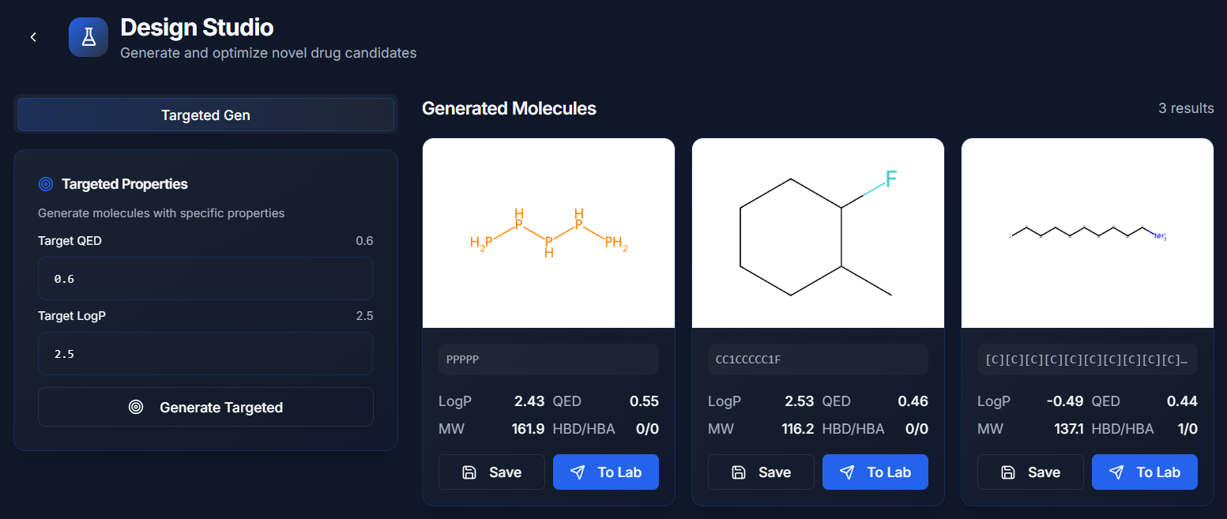
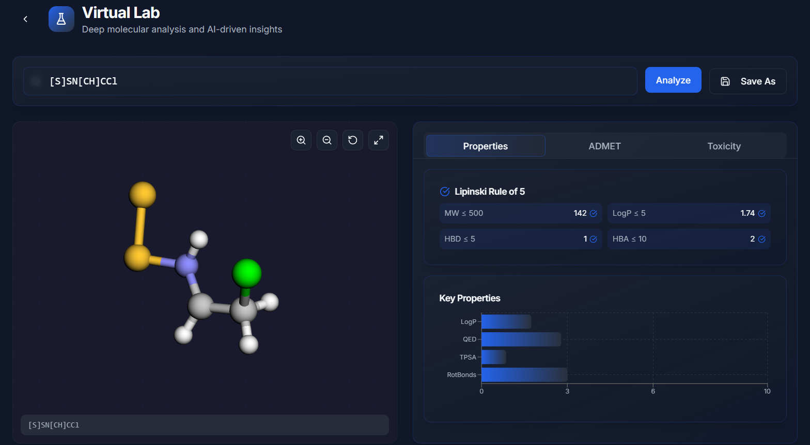

Slide 12
Future Work
Retrain & Scale the VAE Model
larger latent dimension, improved encoder/decoder depth
train on a bigger SELFIES dataset for higher-quality outputs
Enhance Targeted Generation
dynamic weighting for QED / LogP / SAS
multi-objective optimization with smoother convergence
Improve Property Predictor
add more molecular descriptors
fine-tune using richer curated datasets
Reinforcement Learning for Molecule Design
RL agent to guide generation toward user-defined goals
User-Driven Model Retraining
interface to upload custom datasets and retrain models
Advanced Lead Optimization Engine
hybrid gradient + evolutionary search for better exploration

Slide 13
Conclusion
SmartChem demonstrates how AI can accelerate early-stage drug design
Combines generative modeling, analysis, and LLM-guided insights
Provides a complete learning and experimentation ecosystem for students
Framework is extensible for advanced research applications

Slide 14
References
RDKit: Open-source cheminformatics
SELFIES: Self-Referencing Embedded Strings (Krenn et al.)
VAE: Kingma & Welling
Groq LLM API documentation
PyTorch official documentation
MongoDB Atlas documentation

